Slide 1

Team Details
Team name Dragon05
Team leader name Arpit Bhomia
Problem Statement Entrepreneurs often lack the necessary data-driven insights to select optimal locations for starting new businesses. This frequently results in establishing businesses in areas with low demand, while high-demand areas are overlooked, leading to suboptimal business performance and resource misallocation.

Slide 2
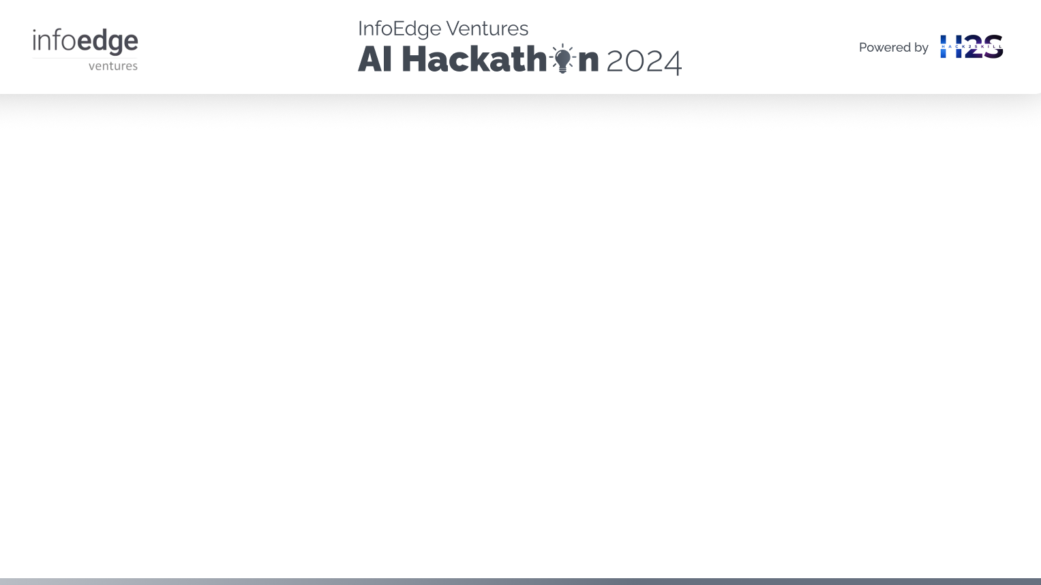
Brief about the idea
Our idea is to develop an AI/ML-based decision support system that leverages data analytics to predict the best locations for new businesses. The system will assess various factors, including: •Population Density: High population areas may indicate a potential customer base. •Average Income: Areas with higher average income might have greater purchasing power. •Competition Analysis: Analyzes the flow and concentration of similar businesses to avoid market saturation. •Demand Analysis: Identifies gaps in the market by analyzing local needs and trends. •Business Impact: Ensures the new business does not negatively impact existing businesses.
The objective of our idea is to enable entrepreneurs to make informed decisions about where to start their businesses, ensuring higher success rates and better service to community needs.

Slide 3
Opportunities
How different is it from any of the other existing ideas?
How will it be able to solve the problem?
USP of the proposed solution
• The innovation aspect of our idea lies in integrating comprehensive socio-economic data analysis, including realtime updates, to predict optimal business locations with high accuracy. This approach goes beyond traditional methods by leveraging advanced AI/ML algorithms to analyze various factors that impact business success.
• Our solution will solve the problem by providing entrepreneurs with data-driven insights and recommendations on the best locations to start their businesses. This reduces the risk of failure due to poor location choices, improves market efficiency by matching business supply with consumer demand, and supports economic growth in underserved areas..
The USP of our idea includes: Precision in Decision Making: Utilizes cutting-edge AI/ML algorithms for accurate location predictions. In-Depth Analysis: Takes into account multiple variables to provide well-rounded insights. Adaptability: Offers customized location recommendations tailored to various business needs.

Slide 4
List of features offered by the solution
• Optimal place to start a business • Provides expected income in that place for that business for a period of according to entrepreneur’s need • Does not result in failures of existing business • Does not add to that much competition in the market • It helps in Making business appear in places of needs to facilitate common people • It provides a variety of choices to choose from along with their statistics

Slide 5
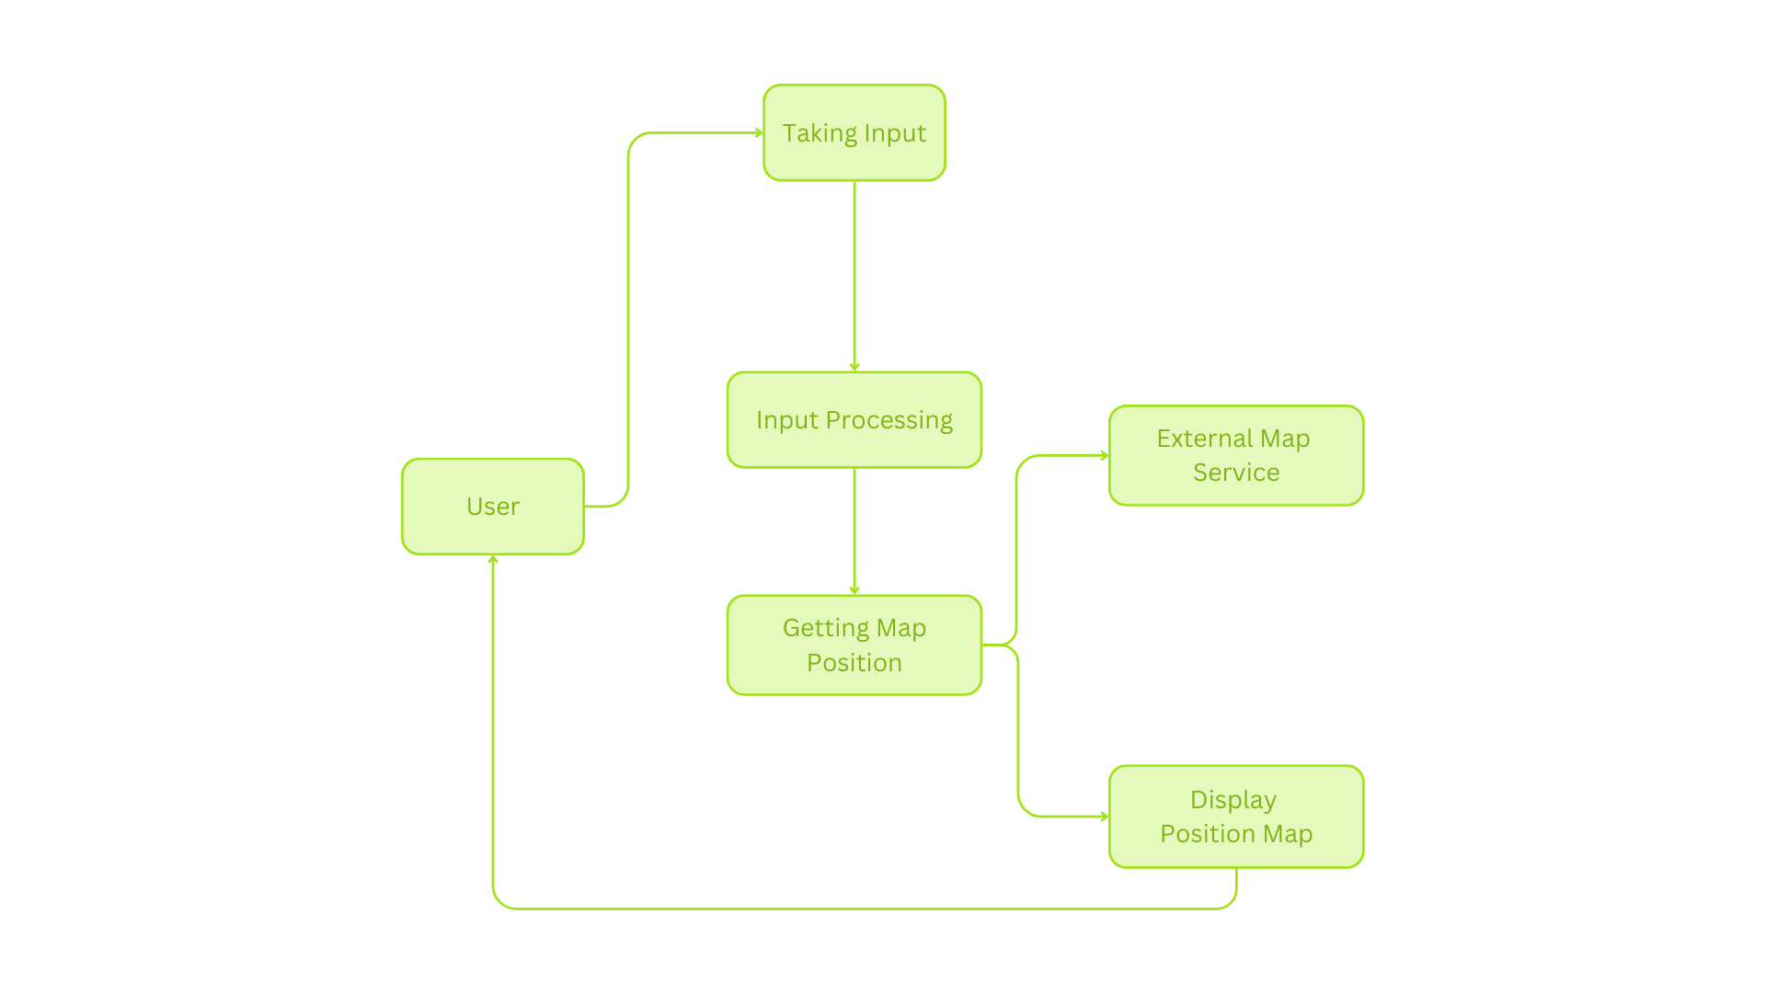
Process flow diagram or Use-case diagram

Slide 6
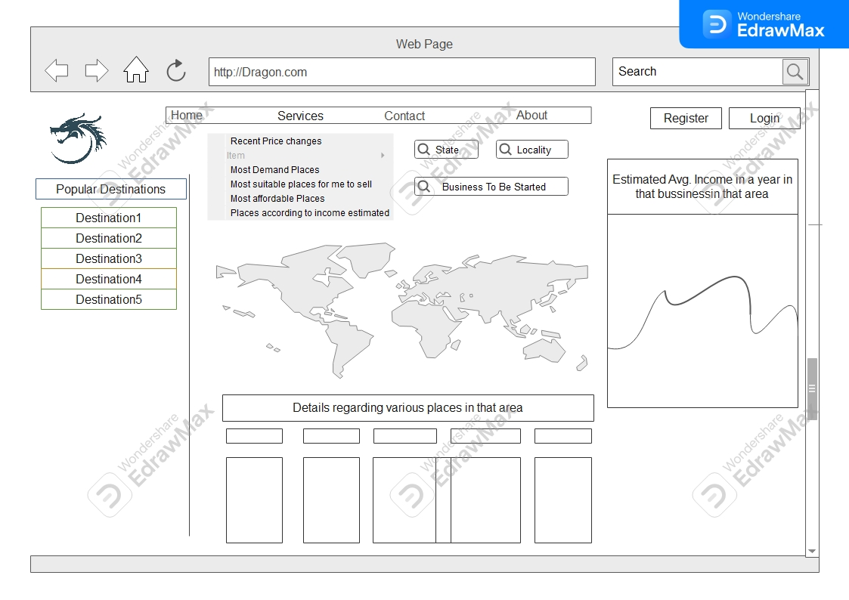
Mock Final Project Diagram

Slide 7
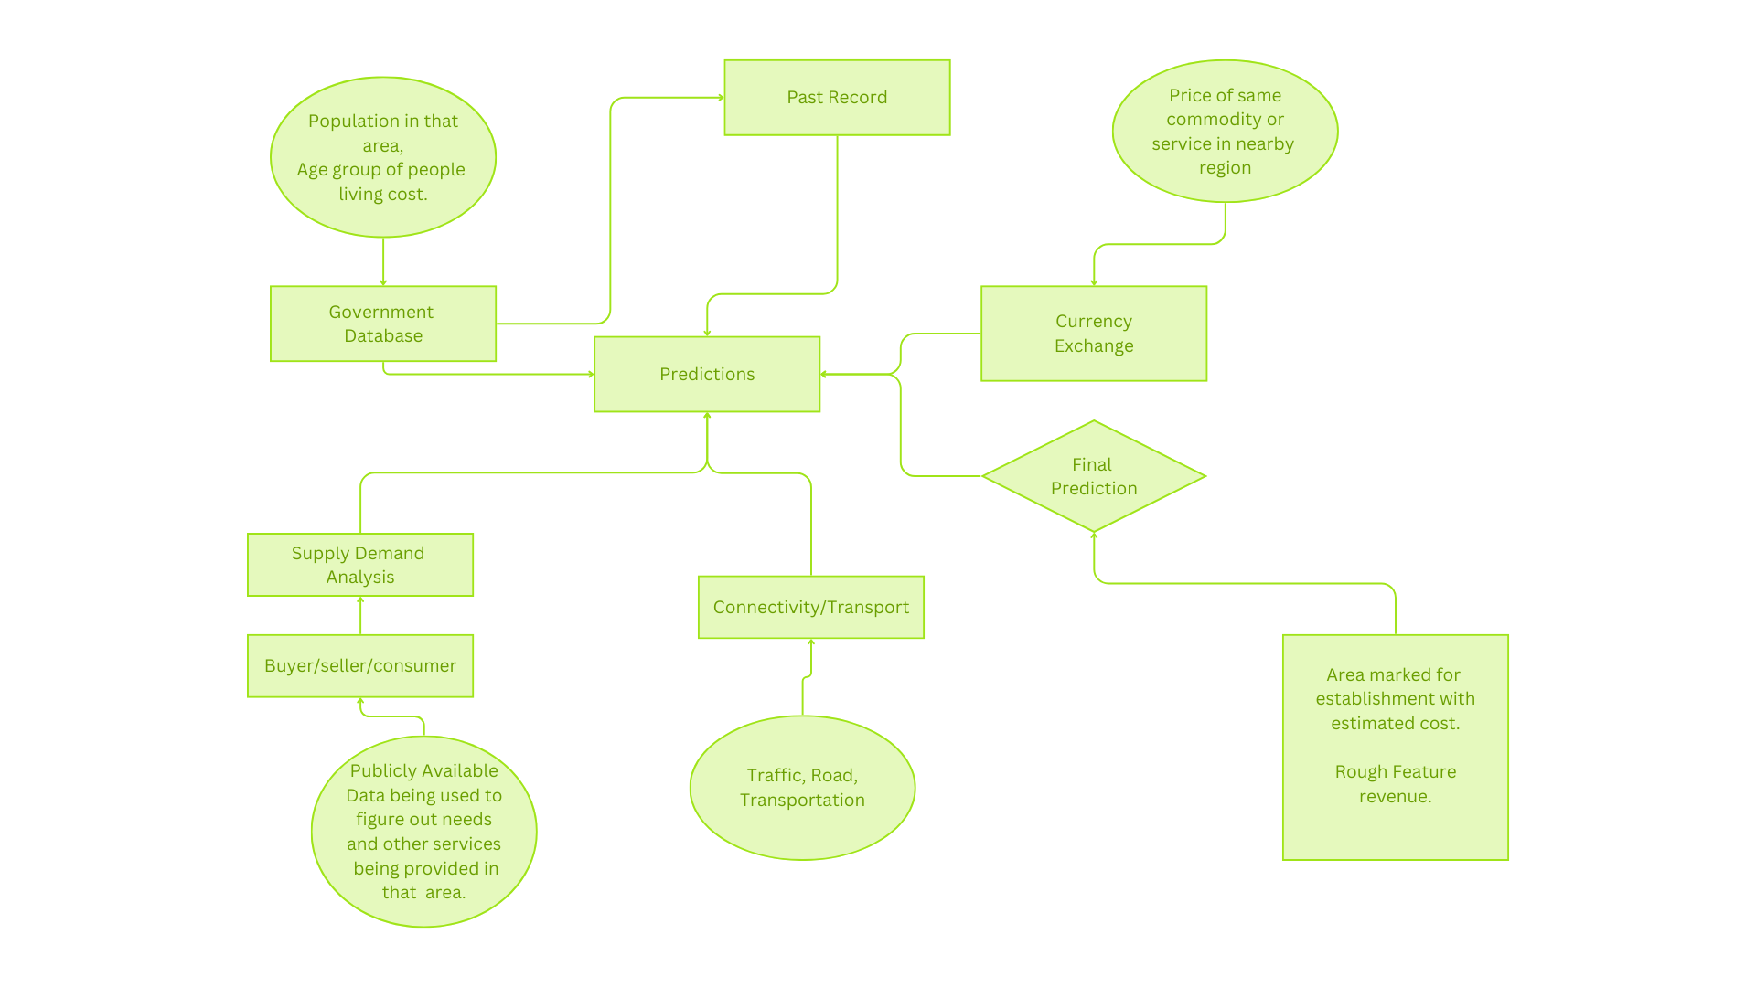
Architecture diagram of the proposed solution

Slide 8
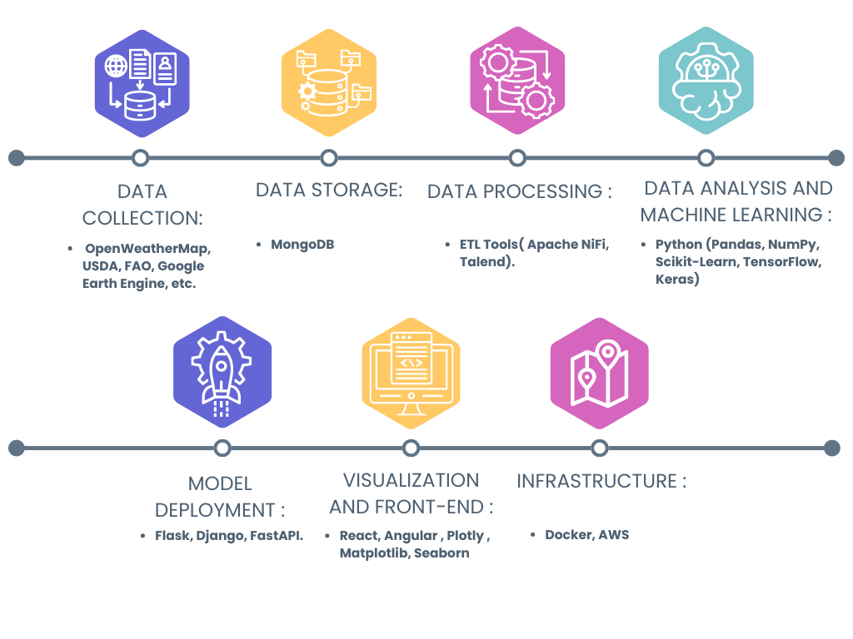
Technologies to be used in the solution

Slide 9
•Estimated implementation cost •API Subscription (OpenWeatherMap): $50/month •Cloud Computing Resources •Development Cost : None •Maintenance Cost : None Total Cost : $50/Month -$200/Month Depending upon the type of cloud services used

Slide 10
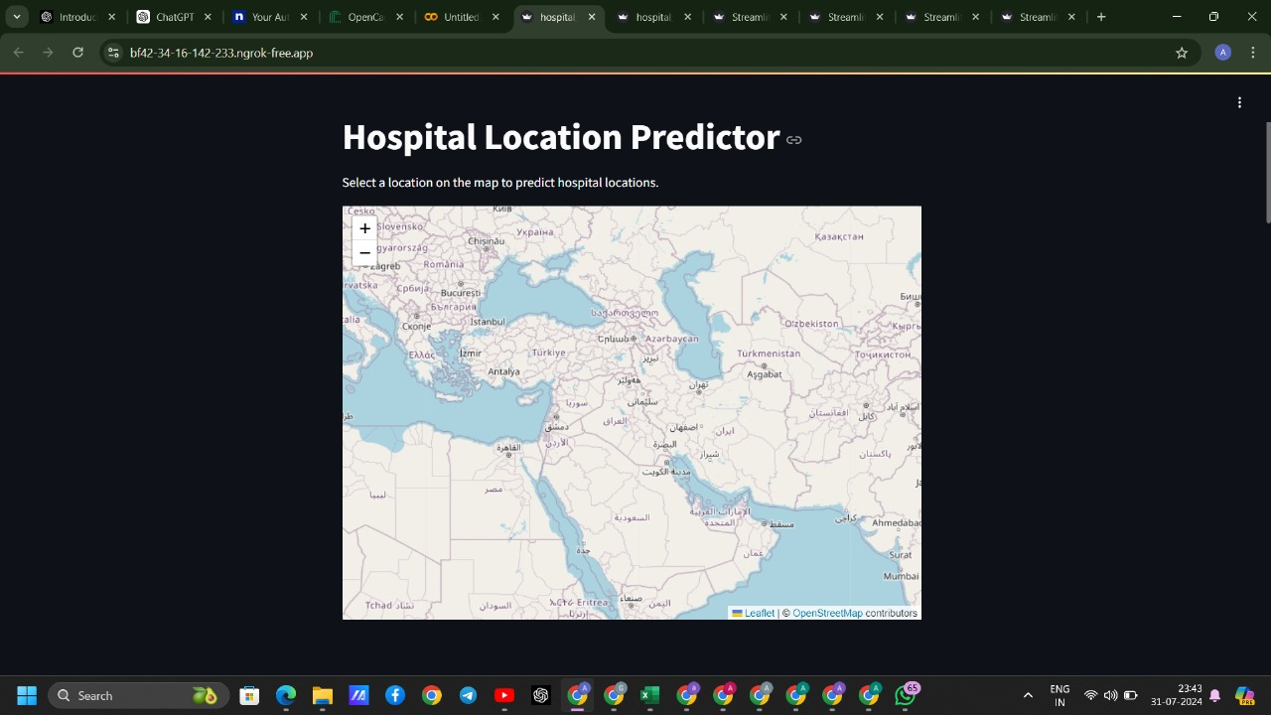
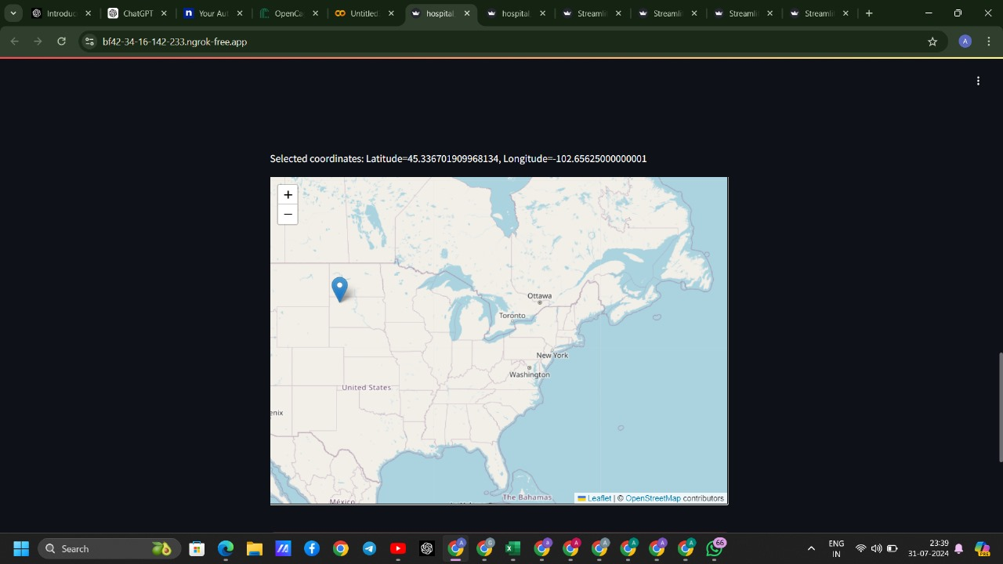
Snapshots of the prototype

Slide 11

Prototype Performance report/Benchmarking
Row-Wise Multi-Threading Overhead:
Testing Overhead: 0.000055 seconds (Initial)
Testing Overhead: 0.000053 seconds (Subsequent)
Col-Wise Multi-Threading Overhead:
Testing Overhead: 0.020171 seconds (Initial)
Testing Overhead: 0.000562 seconds (Subsequent)
Data and Features:
Training Set (Batch 1):
Number of Data Points: 2855
Number of Features: 10
Total Bins: 46
Start Training Score: 37.944938
Training Set (Batch 2):
Number of Data Points: 2855
Number of Features: 10
Total Bins: 46
Start Training Score: -92.885201
Training Set (Batch 3):
Number of Data Points: 194
Number of Features: 10
Total Bins: 44
Training Set (Batch 4):
Number of Data Points: 194
Number of Features: 10
Total Bins: 44

Slide 12
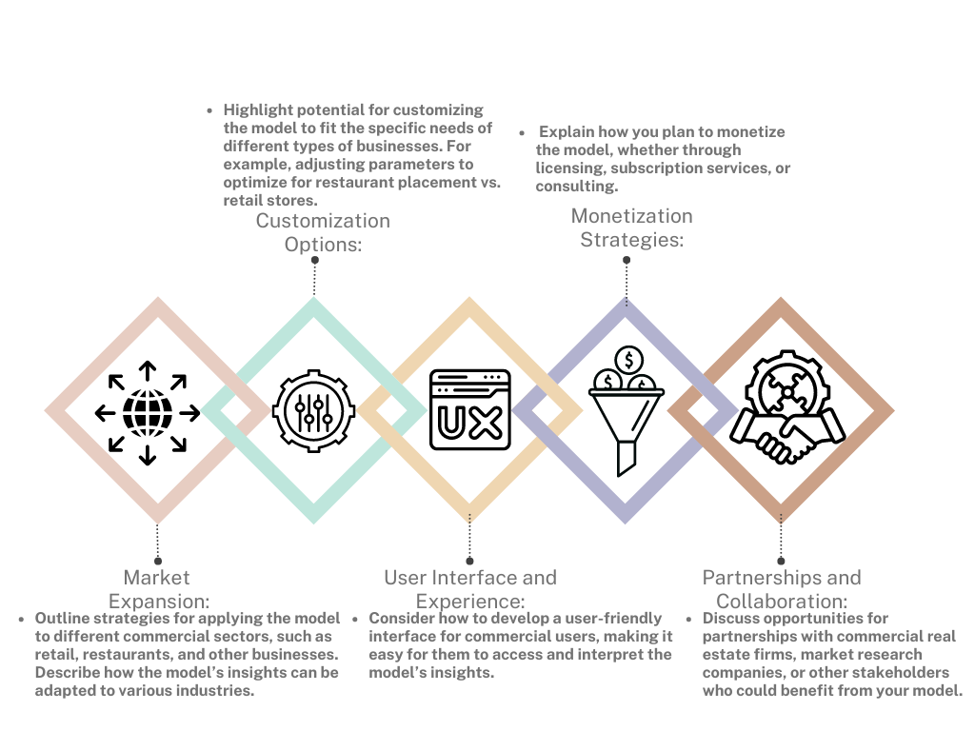
Additional Details/Future Development

Slide 13

GitHub & Demo video URL
https://github.com/KingAB2004/Info_Ventures_AI_Hackathon_Dragon05
https://drive.google.com/uc?id=14PJ5Z3TrzjvzZ7MYjs9L3HBEiJfMgdHU&export=download

Slide 15


